Slide 1

The Organizational Singularity
How agentic AI rewrites the firm and what to build next.

Slide 2


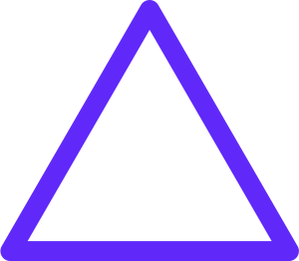
FOCUS TODAY
Publish
Audit
REWRITE
DRIVE
Understand
Design
ExO 3.0 Plan
Build a System
No Plan
No System
Intelligence Stack
Build
Diagnose
No Resilience
Build Resilience
Audit
Build
Design
SHAPE

Slide 3
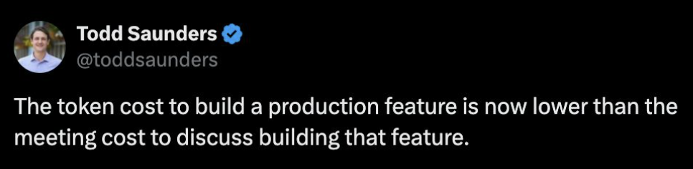
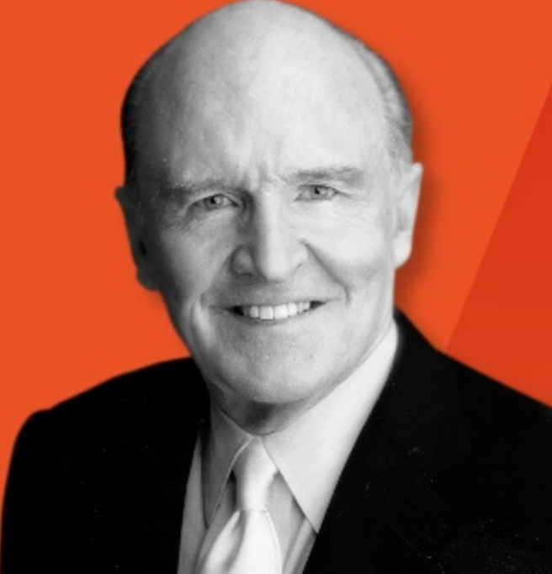
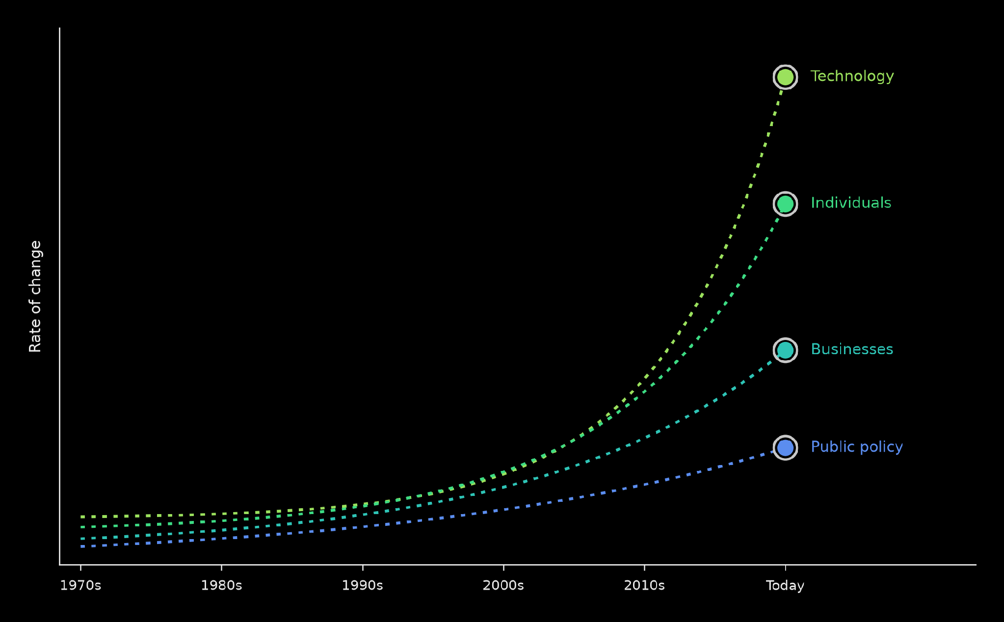
The problem
“If the rate of change on the outside exceeds the rate of change on the inside, the end is near.” Jack Welch
Notes:
88m

Slide 4
04 · THE INTELLECTUAL LINEAGE
80 Years of Thinking About the Firm
Each thinker solved one layer of the problem. This book is the synthesis.
1937
1947
1976
1997
2009
2014
2026
2026
Coase
Simon
Boyd
Christensen
McChrystal
ExO 1.0
Dorsey/Botha
ExO 3.0
Why firms exist
Bounded rationality
Tempo wins
Why winners die
Governed autonomy
Beyond the firm boundary
Hierarchy collapses
The architecture that replaces it
From “why firms exist” → to “the firm boundary is now programmable.”
Full 24-thinker lineage in Appendix D.
The Organizational Singularity · Salim Ismail · v13
05 / 22

Slide 5
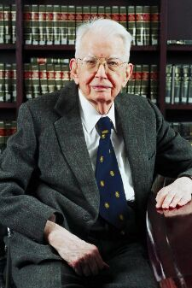
Coase’s Law:
Large companies exist because transaction costs inside are lower than outside
Obsolete
Ronald Coase

Slide 6
04 · THE INTELLECTUAL LINEAGE
80 Years of Thinking About the Firm
Each thinker solved one layer of the problem. This book is the synthesis.
1937
1947
1976
1997
2009
2014
2026
2026
Coase
Simon
Boyd
Christensen
McChrystal
ExO 1.0
Dorsey/Botha
ExO 3.0
Why firms exist
Bounded rationality
Tempo wins
Why winners die
Governed autonomy
Beyond the firm boundary
Hierarchy collapses
The architecture that replaces it
From “why firms exist” → to “the firm boundary is now programmable.”
Full 24-thinker lineage in Appendix D.
The Organizational Singularity · Salim Ismail · v13
05 / 22

Slide 7
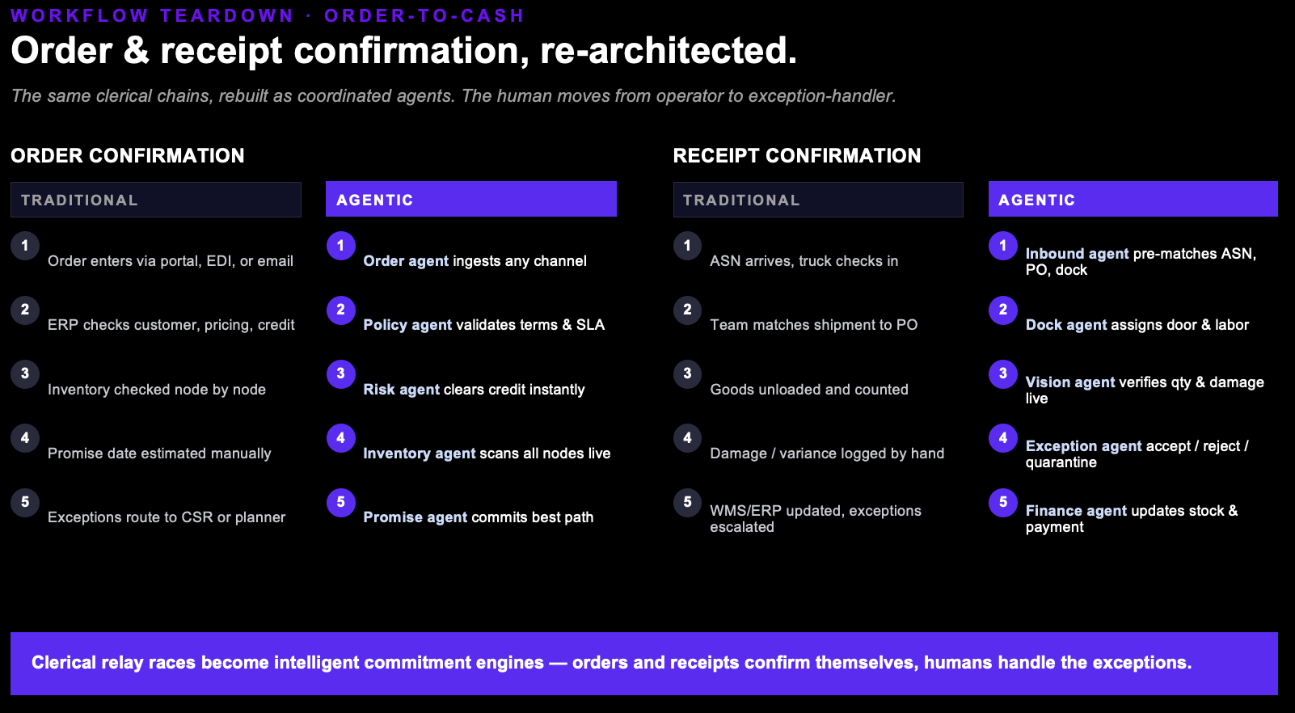
Notes:
Two order-to-cash workflows torn down the same way. Order confirmation: the traditional department-by-department handoff becomes a coordinated set of agents (order, policy, risk, inventory, promise) running in parallel. Receipt confirmation: clerical, reactive dock paperwork becomes a real-time trust/quality/cash decision (inbound, dock, vision, exception, finance agents). In both, the human stops executing the chain and starts governing the exceptions the agents surface.

Slide 8
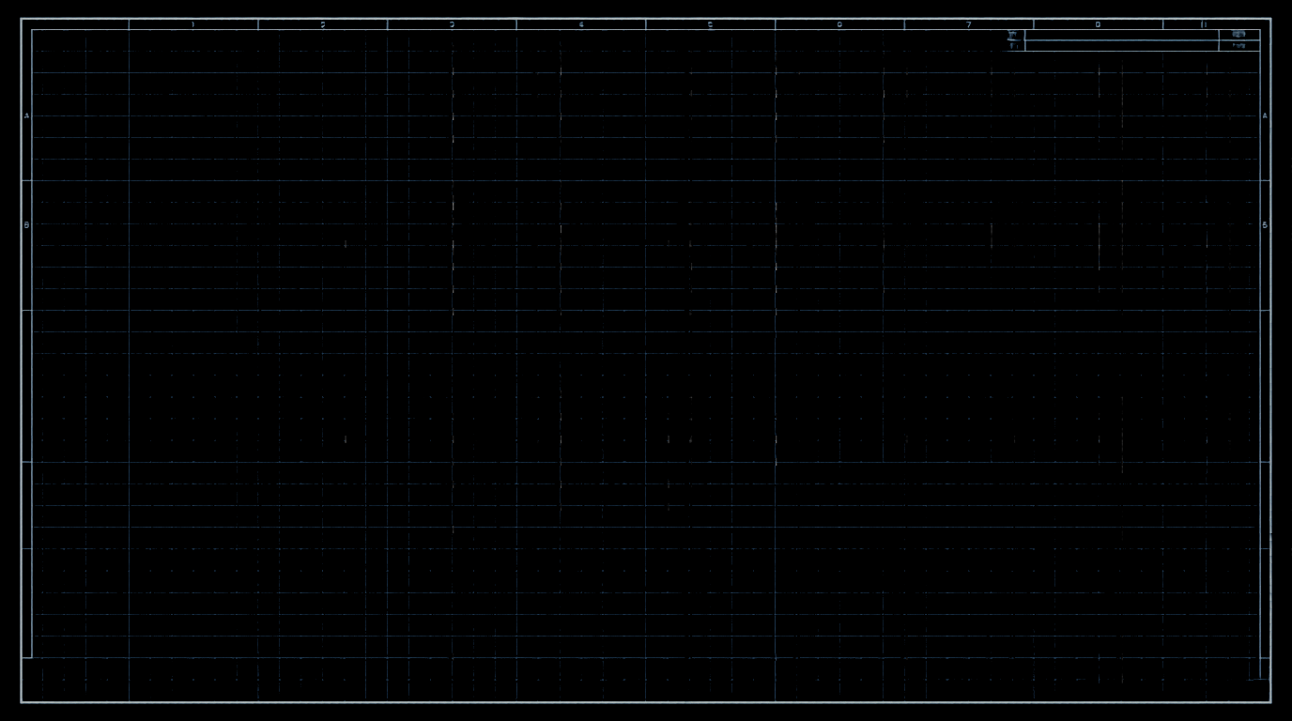

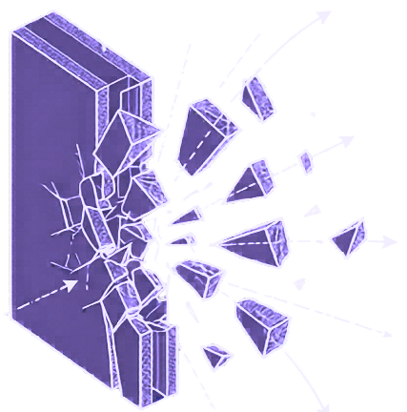

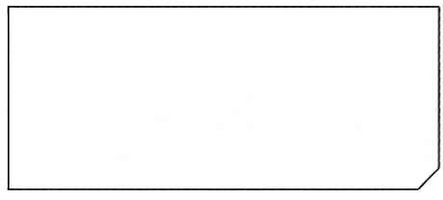
Firm Boundary
The Collapse of Coasean Transaction Costs
The coordination overhead that justified large hierarchical firms is evaporating.
Coordination Overhead
Organizations that once needed 200 people to manage information flow can now route decisions through a mix of human judgment and synthetic intelligence at a fraction of the cost—and at dramatically higher speed.

Slide 9

The Fiduciary Wedge.
The persistent gap between what AI can do and what it can be held accountable for.
“A named human always stands behind consequential decision.”
HIGH-SIGMA → HUMANS
Ambiguous, high-stakes, value-laden decisions stay with named humans.
LOW-SIGMA → AGENTS
Routine, reversible, well-bounded decisions route to agents under audit.

Slide 10
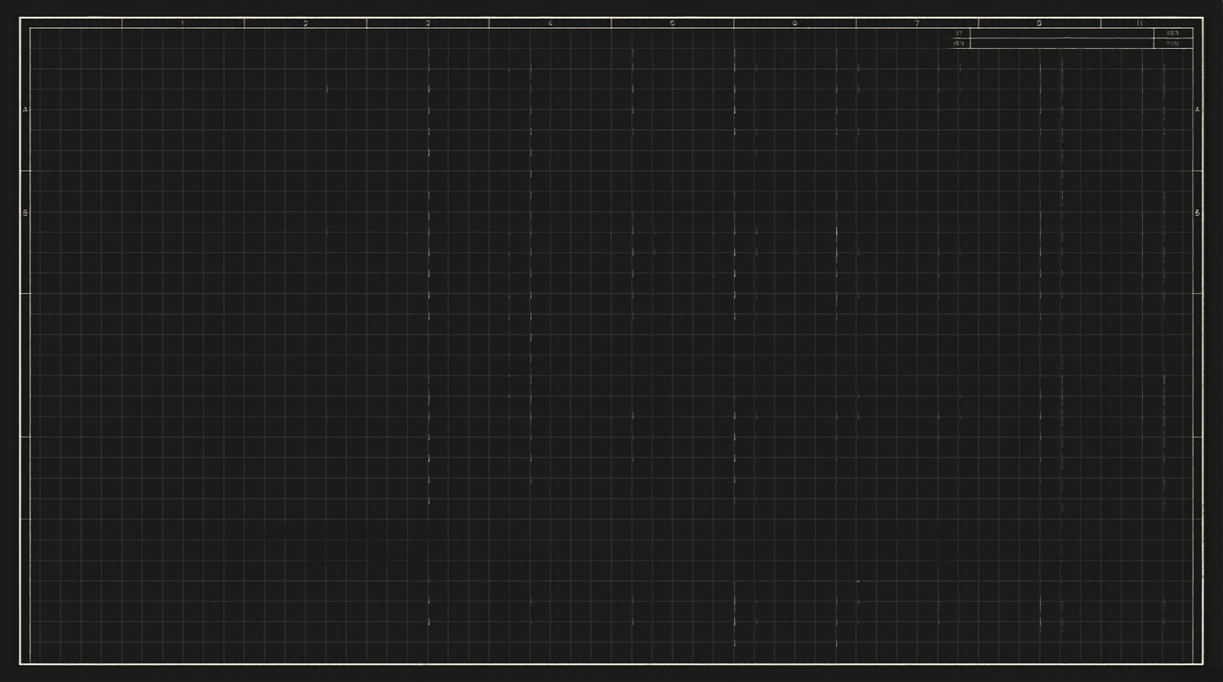


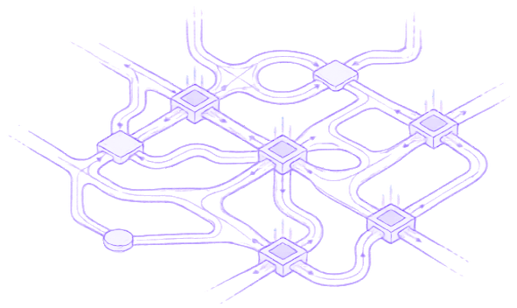
The Fatal Error: Bolting Intelligence onto Legacy Architecture
Bolted-On
Designed-In
Automating the wrong things.
Leaving the deepest friction untouched.
Seamless integration of synthetic nodes into the structural intersections.
You cannot achieve an intelligence-led transformation without an honest accounting of the legacy architecture you are building upon.

Slide 11

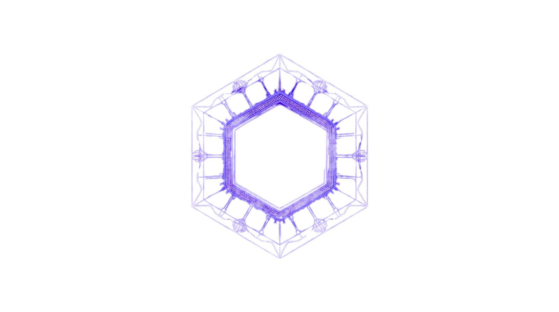

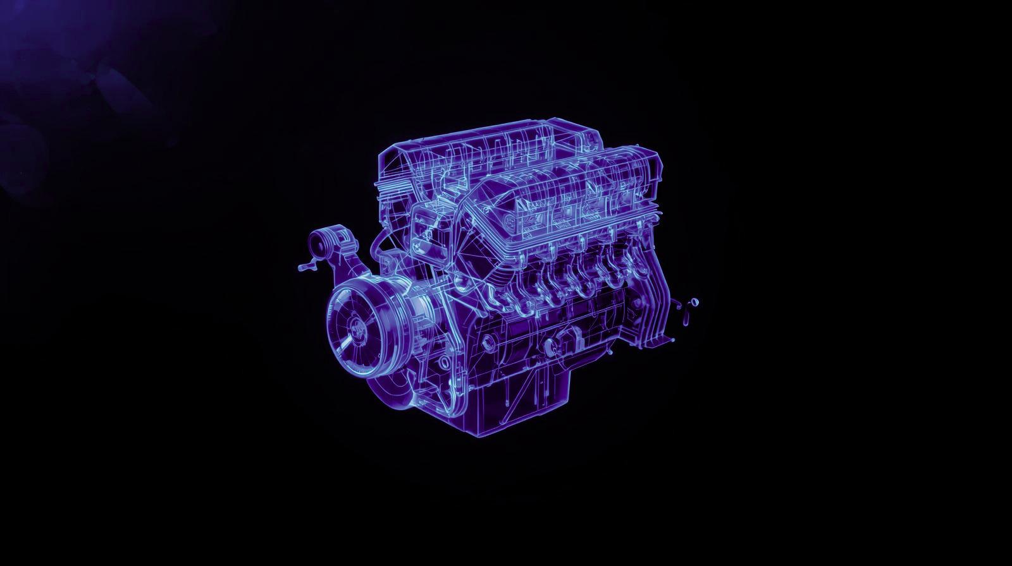
ExO 3.0: the destination architecture.
MTP at the core. DRIVE makes you fast and smart. SHAPE keeps you right and resilient.
DRIVE
The intelligence engine
SHAPE
The organizational form
MTP
Massive Transformative Purpose
The protocol at the core
Decision Architecture
Recursive Learning
Intelligence Stack
Value Moat
Elastic Agency
Safe Autonomy
Human Architecture
Adaptive Architecture
Purpose Control
Ecosystem Trust
DRIVE without SHAPE crashes. SHAPE without DRIVE stalls.

Slide 12
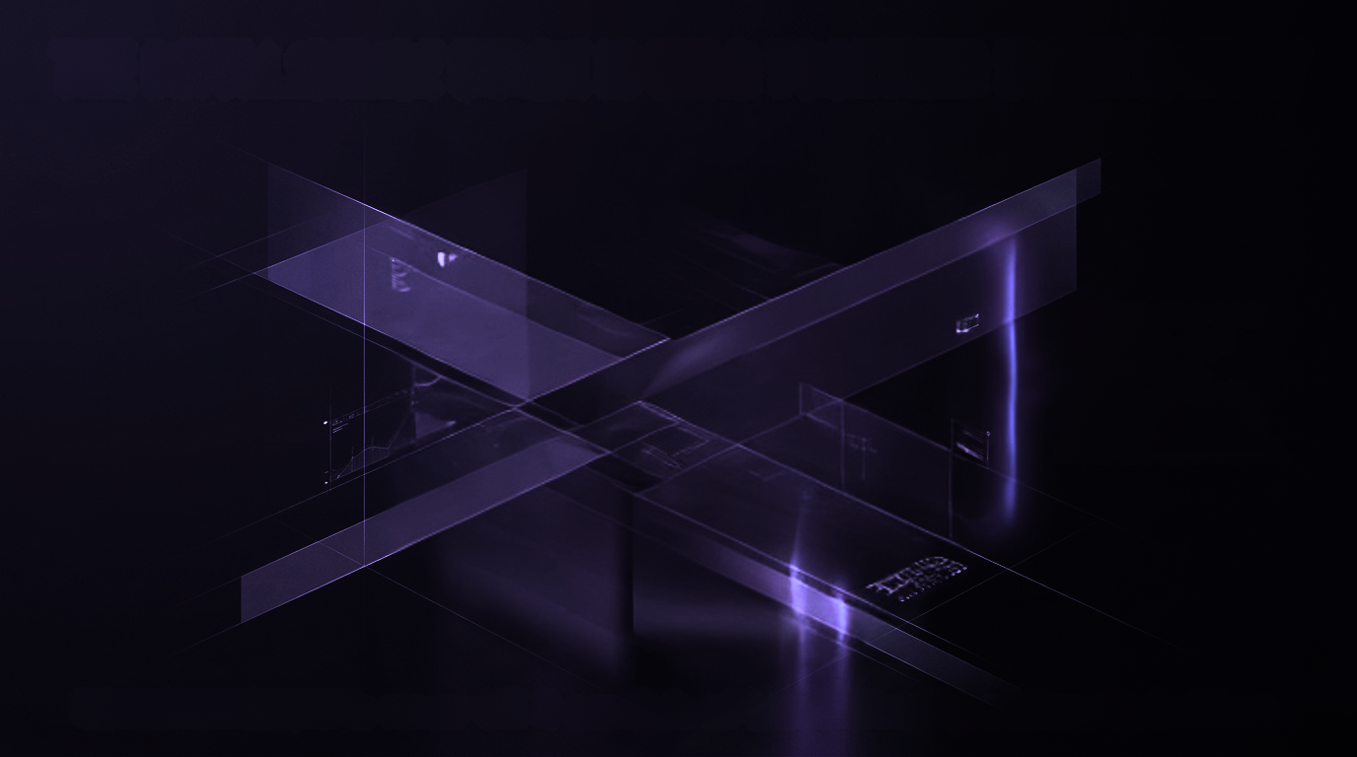
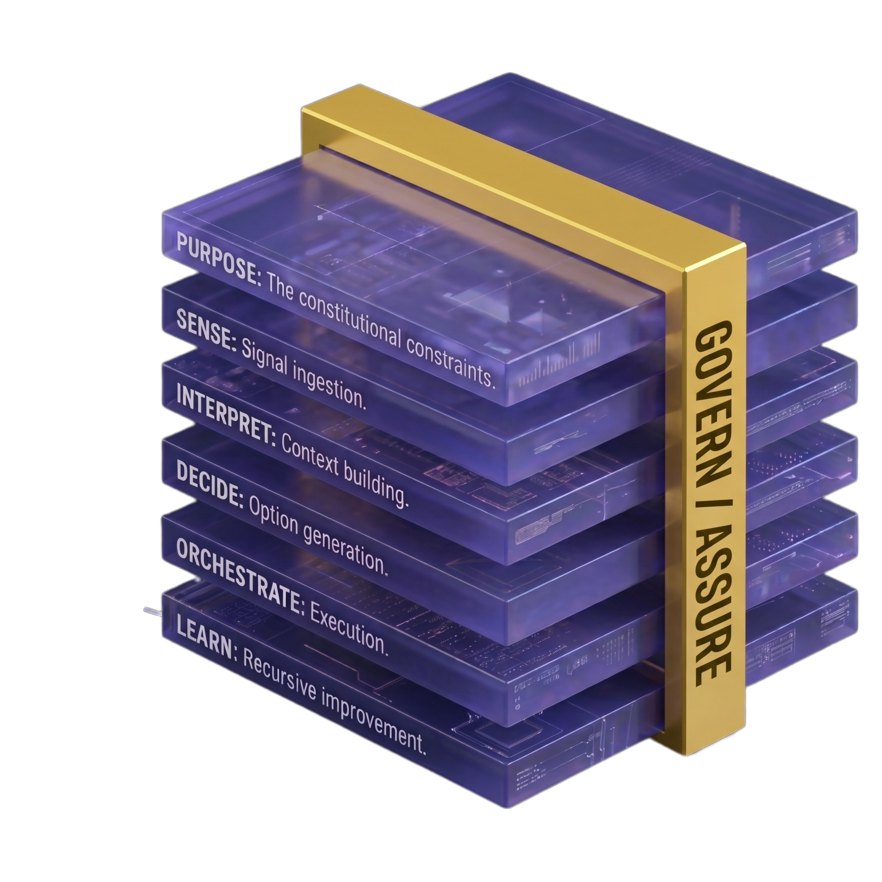
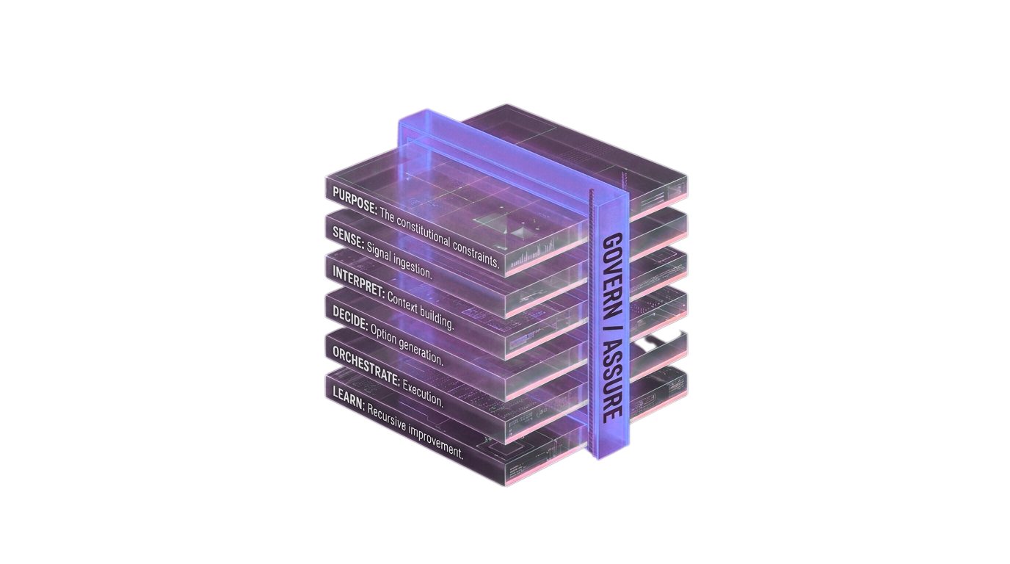


THE INTELLIGENCE STACK
Boyd's OODA loop, operationalized as enterprise architecture running continuously, at machine speed.
GOVERN/ASSURE:
Monitors every layer
in real time. Logs
every decision.
Enforces guardrails.
Triggers escalations.
Owns the kill switches.

Slide 13
GOVERN / ASSURE.
Not an abstract control plane. Four operational primitives. Never off.
01
02
03
04
Trusted Evals
Searchable Logs
Granular Rollback
Human Review Queue
Catch silent drift before customers do.
Audit any decision from the trail alone.
Recover mistakes without taking the Stack down.
Anchor accountability where the law demands one.
GOVERN / ASSURE = Trusted Evals + Searchable Logs + Granular Rollback + Human Review Queue

Slide 14
When your agents talk to their agents.
Cross-firm operation needs architecture, not goodwill. Three requirements.
1
A policy-controlled API surface
External agents get brokered, scoped access. Treat them like API consumers: credentials, rate limits, action whitelists, kill-switch authority.
2
Data-object metadata that travels with the data
What it is, who issued it, how it may be used, what happens if it's wrong. The Six Questions, expressed as machine-readable terms.
3
A liability framework codesigned in advance
Error budgets, mitigation paths, arbitration mechanisms — agreed before any agent transacts. Not in court.
Accountability, not capability, becomes the scarce resource. The most trusted accountability stack is the new Value Moat.
Notes:
9

Slide 15
The Self-Disruption Probe.
A permanent question, running 24/7 at the SENSE layer of your Stack.
“Could a 3-person team with agents rebuild our highest-margin business in 90 days?”
HOW IT WORKS
WHAT TRIGGERS THE ALERT
Environmental Intelligence Agents continuously run shadow simulations of AI-native competitors against your highest-margin functions — modeling staffing, cost structure, execution speed.
If a shadow model can replicate a function at 30%+ lower cost with 50%+ fewer humans, the alert fires. The flagged function becomes the next Edge Twin candidate.
Notes:
10

Slide 16
The Middle 60% problem.
This is the architectural decision that determines whether transformation lands or backfires.
TOP 20%
MIDDLE 60%
BOTTOM 20%
Thrive
The honest crisis
Displaced first
High-judgment operators. Promoted, paid more, given larger scope. The new “AI elite” (WRITER 2026: 92% of execs say they're cultivating this tier).
Excellent coordinators and process managers exactly the work AI compresses. Telling them they're now “exception handlers” is a category error dressed as opportunity. The architectural question of the decade.
Routine task executors. Already moving. The political math says: their displacement is the precedent for what happens to the Middle 60% next.
Dignity is a design parameter, not an afterthought. Engineer the bridge before announcing transformation publicly.
Notes:
11

Slide 17
Don't transform the core.
Outcompete it.
Outcompete it.
The mothership is optimized for predictability and efficiency, antithetical to disruptive innovation. Every "transform the core" attempt runs into the immune system. Build at the edge.
Notes:
12

Slide 18











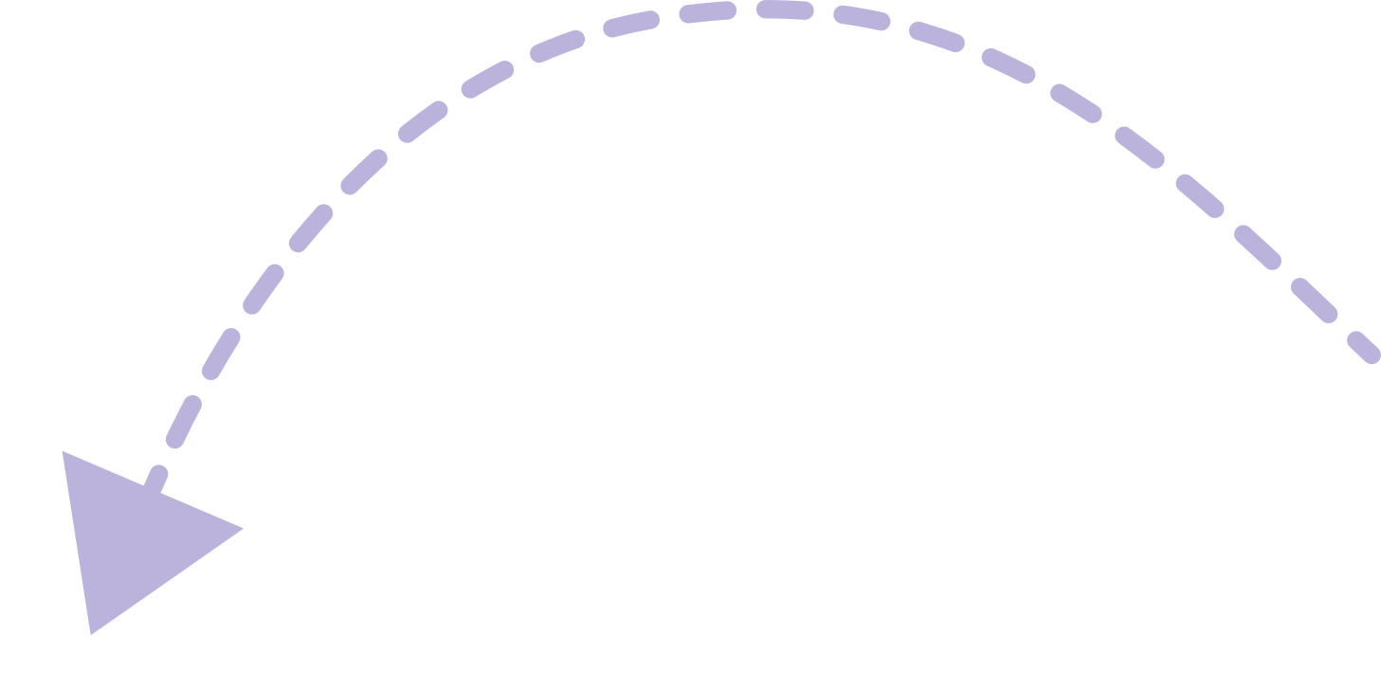
14 / 20
Edge deployment, in four phases.
Mothership shrinks. Edge grows. The edge becomes the firm.
Phase 1:
The Legacy Mothership
Phase 2:
The Edge Twin Spawns
Phase 3:
Workflow Migration
Phase 4:
The New Center of Gravity
Edge Twin
(AI-Native Team)
The AI-Native Firm
Traditional Hierarchy
Core Shinks, Edge Outperforms
High Coordination Costs
Mothership
unchanged
Mothership
Massive Intelligence-Dense Entity
Reporting Directly to CEO
Human-Centric Workflows
Phase 1:
The Legacy Mothership
Phase 2:
The Edge Twin Spawns
Phase 4:
The AI-Native Firm
Workflows Migrate
NotebookLM
Notes:
13

Slide 19
Two sectors already lived this.
Same arc, different industries. The pattern is structural.
CONTACT CENTERS
MARKETING & CREATIVE PRODUCTION
Phase 1: Human BPO
~10M agents globally. Convergys, Teleperformance, Concentrix. $5–15 per contact.
Phase 2: Chatbot assist
20–40% deflection. Where most “AI strategy” still lives.
Phase 3: AI-native
Klarna: 700 FTE replaced, $40M margin. Decagon · Sierra · Cresta · BAC Erica (1B+ interactions). 10–100× cheaper per contact.
Phase 1: Agency-heavy
WPP · Omnicom · Publicis · IPG. ~500K people, $50B+ in fees. Assets $1K–$100K each.
Phase 2: AI-assisted
Adobe Firefly, Canva, early Jasper. 20–40% faster inside agency workflows.
Phase 3: AI-native
Midjourney · Runway · Synthesia · ElevenLabs. Klarna: ~$10M/yr saved cutting agencies. 100–1000× cheaper per asset.
The question is no longer whether your sector goes through this arc. It is when, and whether you lead it from the edge or get displaced from the core.
Notes:
14

Slide 20
REWRITE: six sequenced steps.
The sequence is non-negotiable. Governance lives across every step.
01
02
03
04
05
06
Backcast
Assess
Extract
Strip
Build
Rewire
Define the destination architecture. Validate against the Five Design Conditions.
REWRITE Readiness Score. Intelligence audit. Capability gap.
Map workflows. Identify the highest-value Edge Twin candidate.
Cut organizational drag. Compress approval chains.
Stand up the Edge Twin. Migrate one workflow. Prove. Repeat.
Pod-based intelligence networks. The edge becomes the firm.
ONE PRINCIPLE · GOVERN / ASSURE operates from Day 1 across every step. Never turned off.
Notes:
15

Slide 21
The Turbulent Transition.
2026–2031. Most firms inhabit a structural no-man's land. The P&L gets worse before it gets better.
DUAL COSTS, J-CURVE
UNEVEN SECTOR TIMELINES
Pay for both the legacy org AND the AI-native edge. Cost crossover: typically Month 18–30. Boards that don't understand this kill the initiative at the trough.
Information-centric: months. Hybrid (manufacturing, retail, logistics): 1–3 years. Regulated (financial services, healthcare, gov): 3–7 years. Pace against your own sector, not your peers.
LABOR DYNAMICS
GEOPOLITICAL FRAGMENTATION
Bifurcation risk becomes class structure. Without deliberate architecture, you get a caste system that kills the rollout politically before it can prove itself economically.
Cognitive blocs: US, China, EU, India each developing distinct stacks. Firms operating cross-bloc need translation layers, parallel auth, degraded-mode protocols.
Pre-fund the J-curve at the board on Day 1. Prove fast on a small workflow. Govern from Day 1.
Notes:
16

Slide 22
The 2036 firm. 100x more Performant
Small human cores, massive intelligence layers, firms that act more like protocols than institutions.
50
1:20+
73×
humans where 2024 had 500
manager-to-IC ratio
Cognition Labs' ARR growth
Not because it does less. Because it does 10× more.
Coordination collapses. Middle management disappears as a layer.
Sub-$20M burn. The new revenue-per-employee curve.
“Every company can now be a mini-AGI.” — Jack Dorsey, March 2026
Notes:
17

Slide 23
What survives.
In every phase transition, the winning traits change. The dinosaurs were optimized for a world that disappeared in an afternoon.
SURVIVES
DOES NOT
The MTP, encoded as protocol.
The accountability shell: legal entity, fiduciary holder.
The proprietary intelligence in LEARN, the data your competitors can't have.
The coordination protocols, Buterin's mechanism designs, scaled by LLM-relieved attention.
Curatorial judgment when execution is nearly free, taste becomes the moat.
Proprietary Data !!
The org chart as we built it.
The five-year plan.
Middle management as a coordination layer.
Quarterly strategy reviews as the unit of decision-making.
Inertia moats, “customers don't switch because switching is annoying.”
Wasting assets in the agent economy.
Notes:
18

Slide 24
20 / 20
Build the Stack first.
The dabbling era is over.
Diagnose the one weakest characteristic that is choking your bottleneck. Rebuild around it. Then the next. The architecture compounds.
Notes:
19

Slide 25
FOCUS TODAY
Publish
Audit
REWRITE
DRIVE
Understand
Design
ExO 3.0 Plan
Build a System
No Plan
No System
Diagnose
Intelligence Stack
Build
No Resilience
Build Resilience
Audit
Build
Design
SHAPE

Slide 26
Four takeaways today:
A Backcasting
REWRITE Score /70
Workflow mapping
Build plan with governance layer
Please use the Workbook

Slide 27
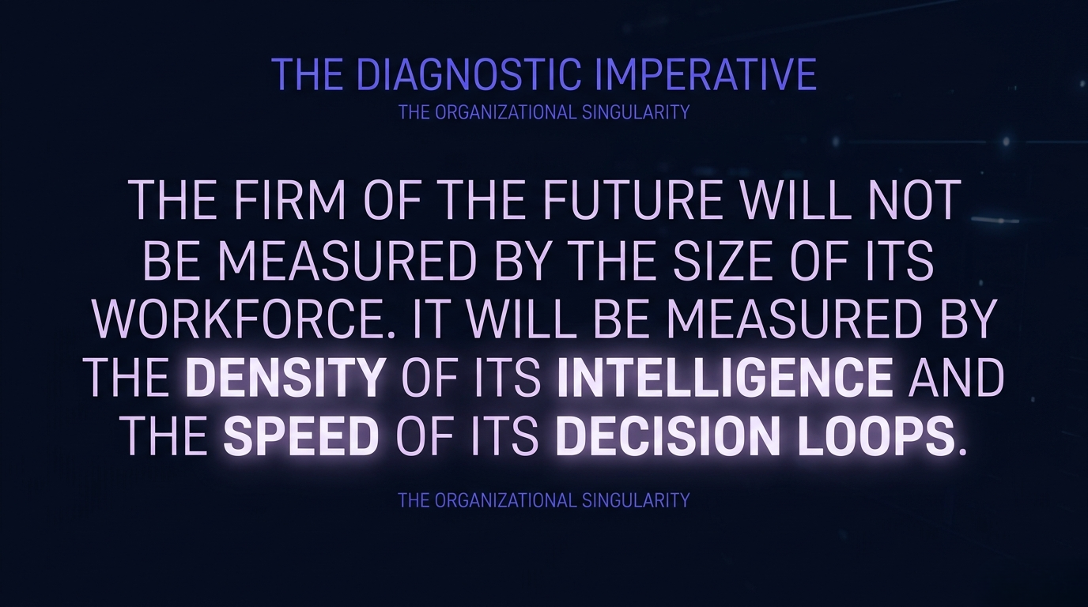

Slide 28
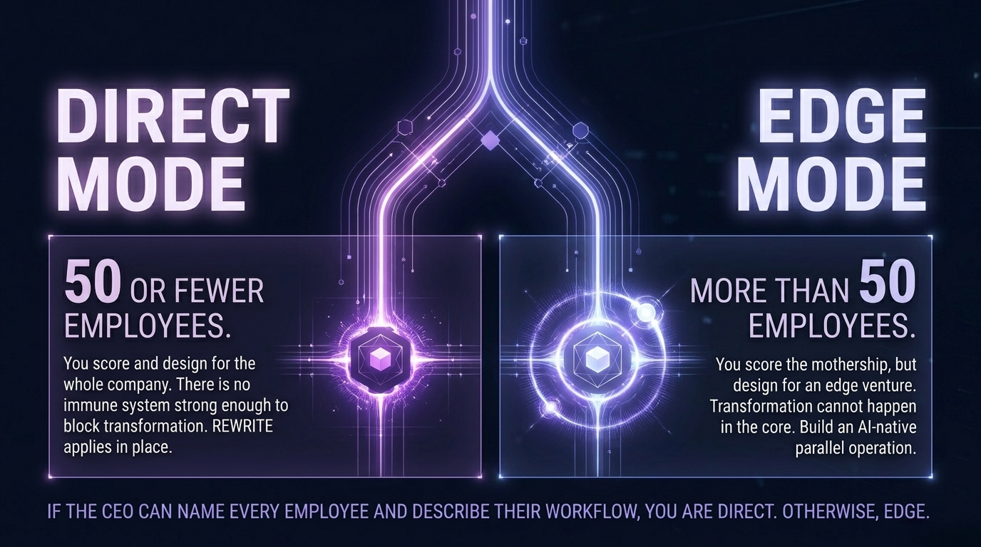

Slide 29
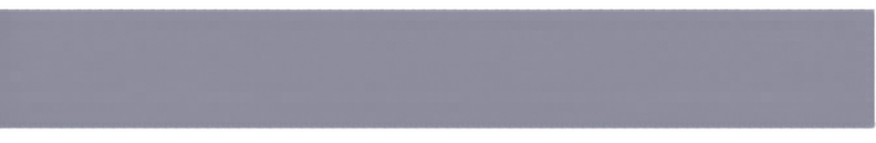





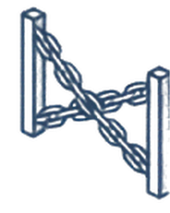
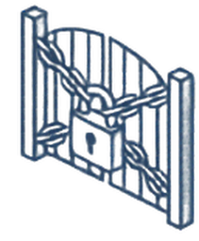



Backcasting: Why Your AI Transformation Starts in the Future
TODAY FORWARD PLANNING
BACKCASTING
(Legacy Constraints)
(Principled Destination)
Carries Legacy Constraints
Defines the Principled Destination First
Traditional planning uses the existing org chart and approval processes as gravitational limits on every AI initiative.
Leaders define a vision of a future “Destination Architecture” and work backward to connect the present to that goal.
Existing Org Chart
FUTURE
“Destination Architecture”
Backcasting is
the Non-Negotiable Step 1
INSURANCE POLICY
Every observed REWRITE failure where the technology worked but the initiative stalled traces to a missing destination definition.
Approval Processes
BLUEPRINT & MANDATE
Execute the Backcasting Canvas Workshop
Present
Conduct a 2–3 day facilitated session to secure a signed mandate and a detailed blueprint of the future firm.

Slide 30
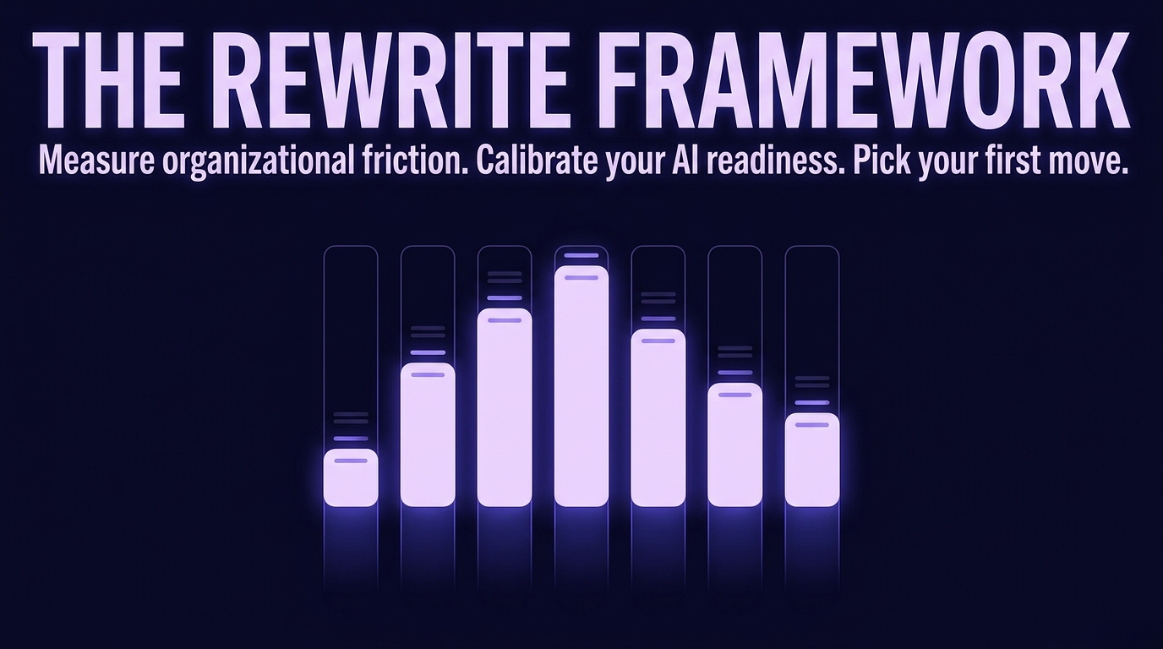

Slide 31
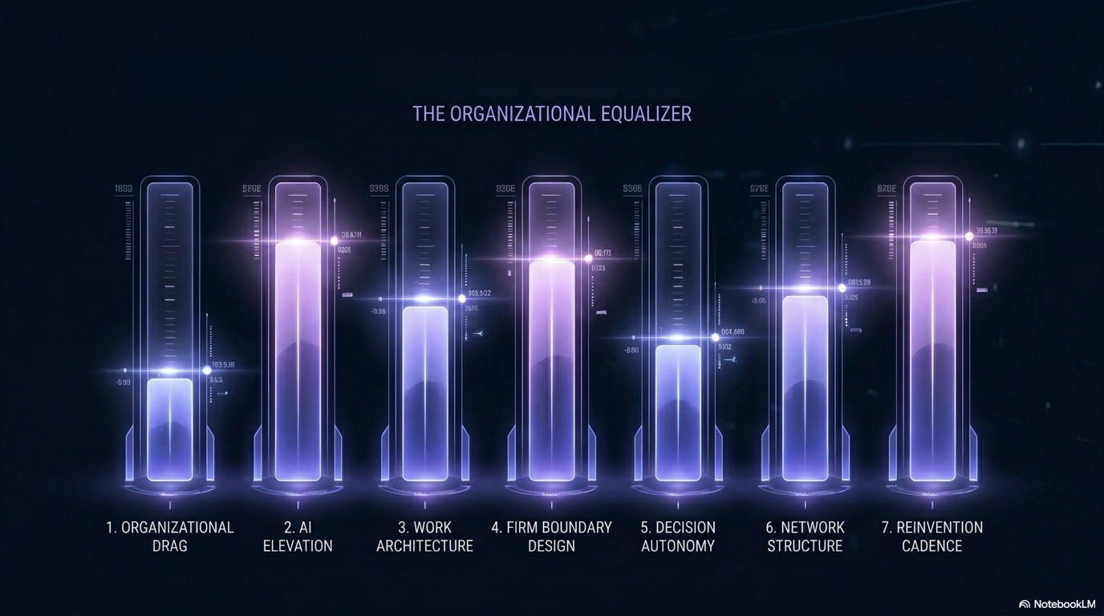
THE 7 REWRITE DIMENSIONS

Slide 32

Organizational Drag measures internal friction and decision latency.
2
3
4
5
6
7
8
9
10
Score 1 (Legacy): High drag.
Defined by approvals, committees,
and review theater.
Score 10 (Al-Native): Low drag.
Decisions are executed seamlessly
at the lowest competent level.

Slide 33
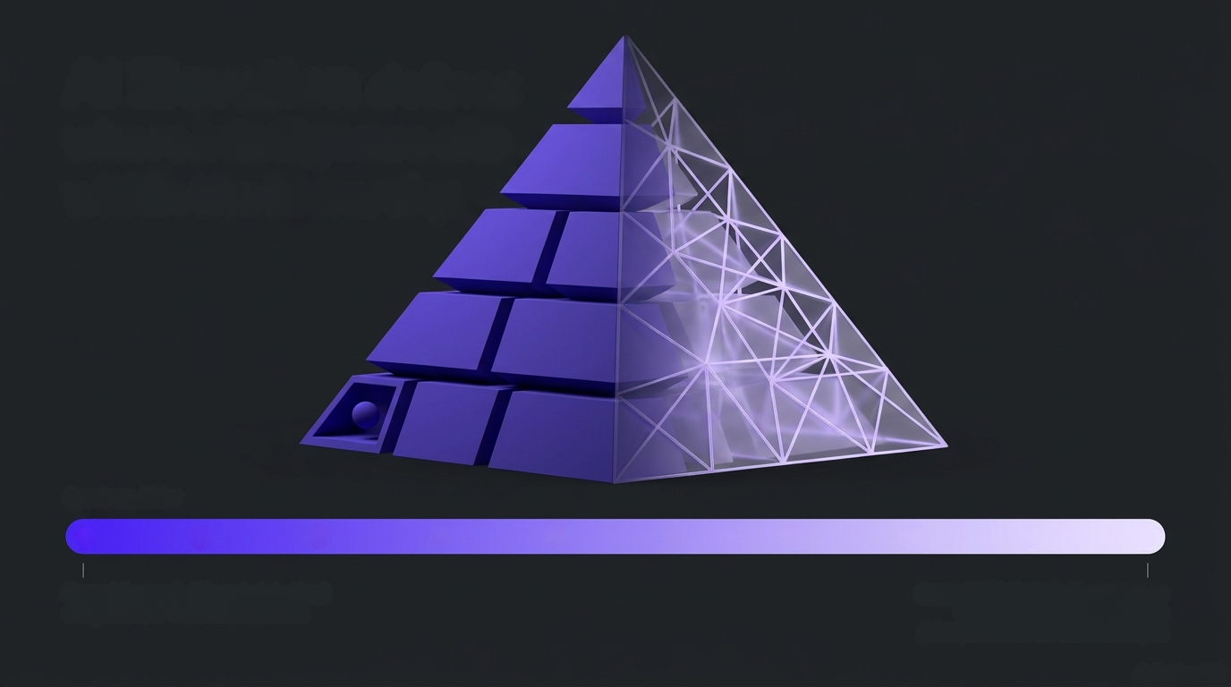
Al Elevation defines
where intelligence sits
within the hierarchy.
1
2
3
4
5
6
7
8
9
10
Score 1 (Legacy): Al is an isolated tool
relegated to IT or an innovation lab.
Score 10 (Al-Native): Al operates as
the core organizational design
principle across the executive layer.

Slide 34
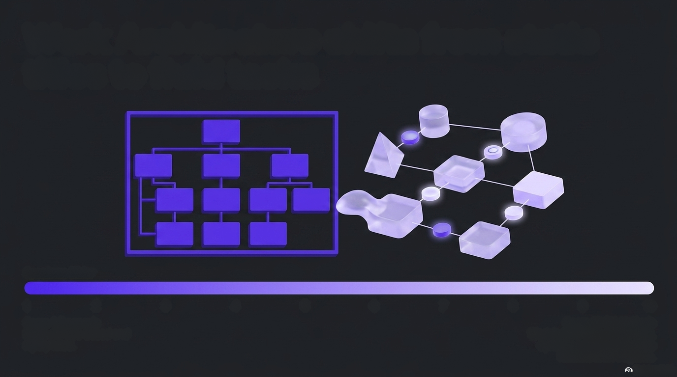
Work Architecture shifts from static titles to fluid tasks
1
2
3
4
5
6
7
8
9
10
Score 1 (Legacy):
Roles are title-based and rigidly fixed.
Score 10 (Al-Native):
Work is task-based, with fluid,
dynamic assignment across
humans and Al agents.

Slide 35
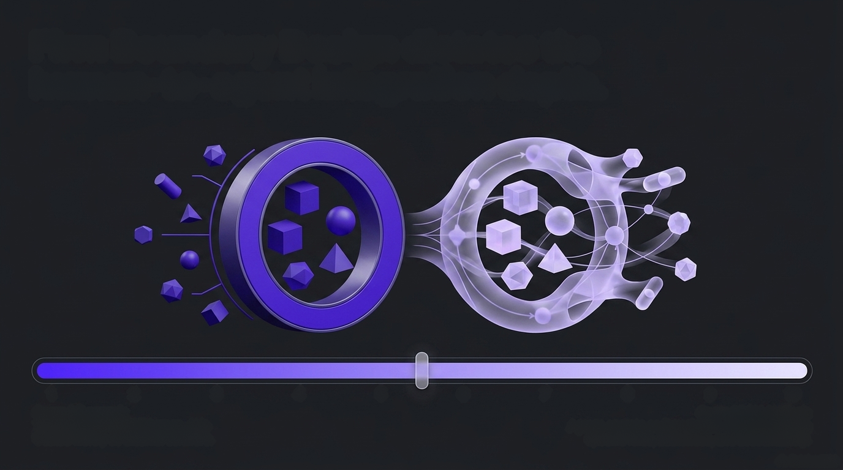
Firm Boundary Design dictates the
human-to-agent integration depth.
1
2
3
4
5
6
7
8
9
10
Score 1 (Legacy):
The workforce is 100% human. Al is
treated merely as external software.
Score 10 (Al-Native):
Agents operate as formal team members holding
specific roles, authorities, and accountability.

Slide 36
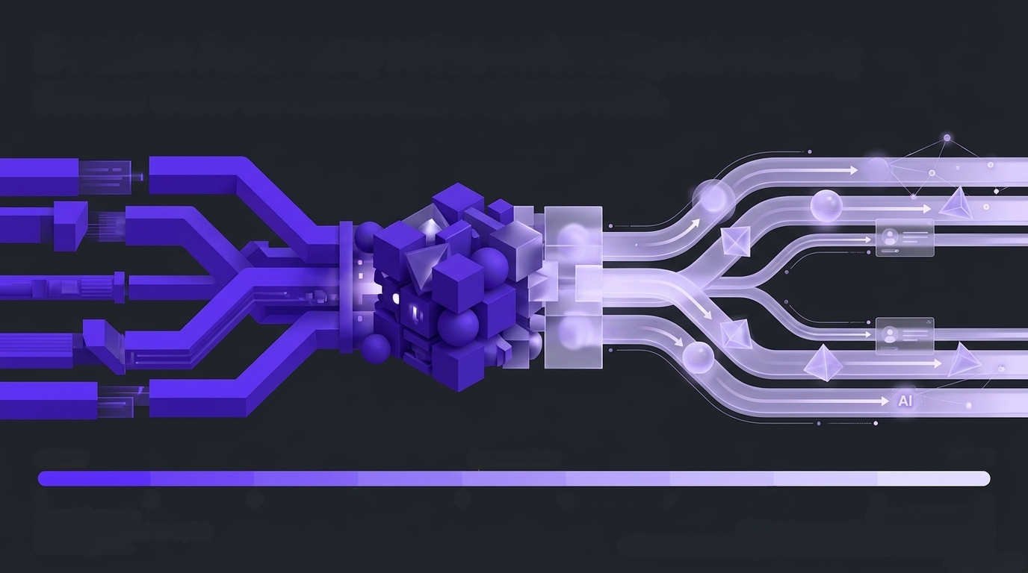
Decision Autonomy relies on intelligent routing
rather than bottlenecked approvals.
AI
1
2
3
4
5
6
7
8
9
10
Score 10 (Al-Native):
Clear, autonomous routing systems perfectly
differentiate between agent-decided and human-decided actions.
Score 1 (Legacy):
Every decision requires explicit
human approval.

Slide 37
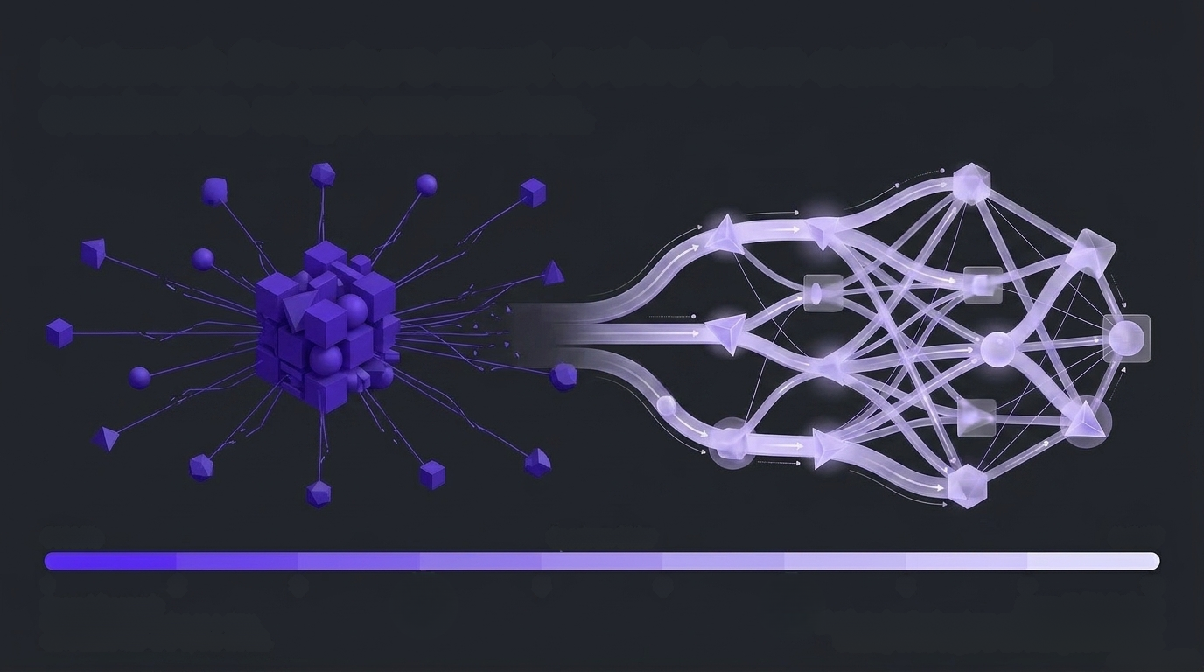
Network Structure must evolve from centralized
control to edge execution.
1
2
3
4
5
6
7
8
9
10
Score 1 (Legacy):
Rigid hierarchy relying on a slow, centralized hub-and-spoke model.
Score 10 (Al-Native):
Distributed authority where critical decisions happen
instantly at the edges of the intelligence network.

Slide 38
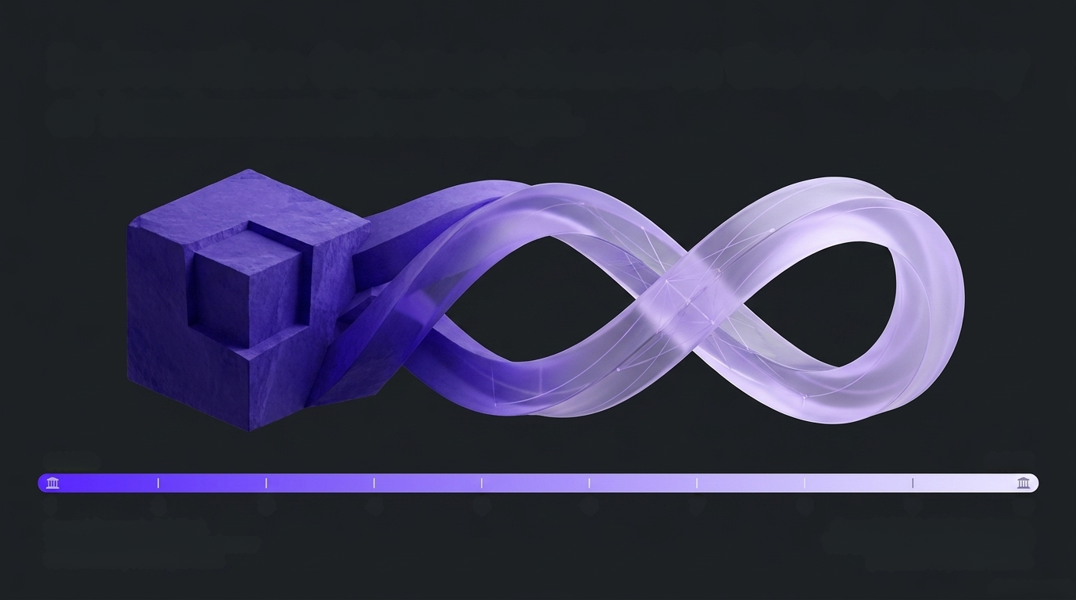
Reinvention Cadence measures the frequency
of fundamental redesign.
1
2
3
4
5
6
7
8
9
10
Score 1 (Legacy): Calcified.
The organization is frozen and never
fundamentally redesigns itself.
Score 10 (Al-Native): Continuous.
The organization exists in a state of perpetual corporate rebirth.

Slide 39
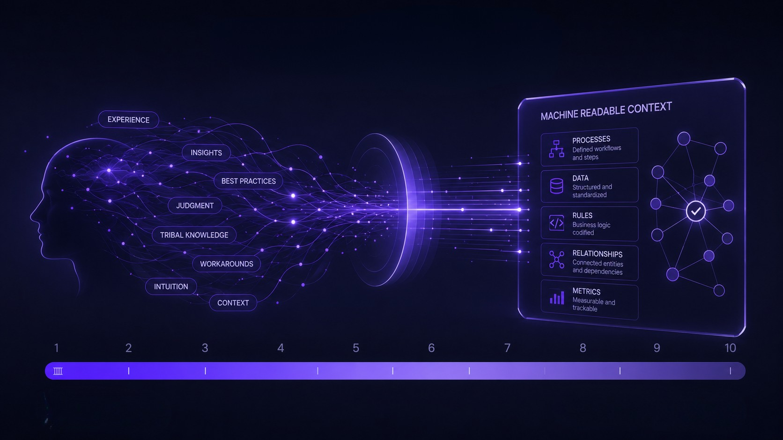
Tacit Knowledge Accessibility measures whether your operational context is machine readable.
Score 1 (Legacy): Knowledge is trapped inside individuals heads and email threads
Score 10 (Al-Native): Systematically codified and updated via continuous elicitation agents.

Slide 40
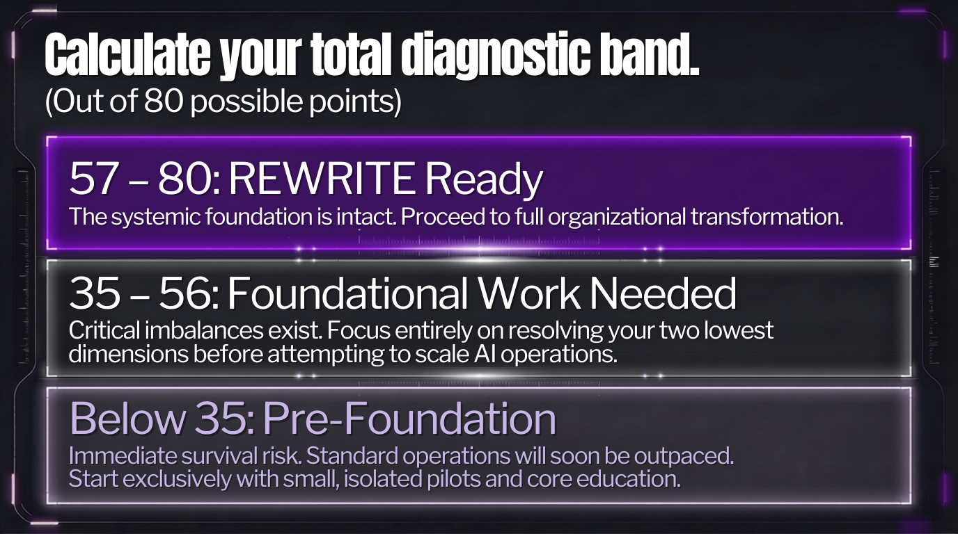

Slide 41
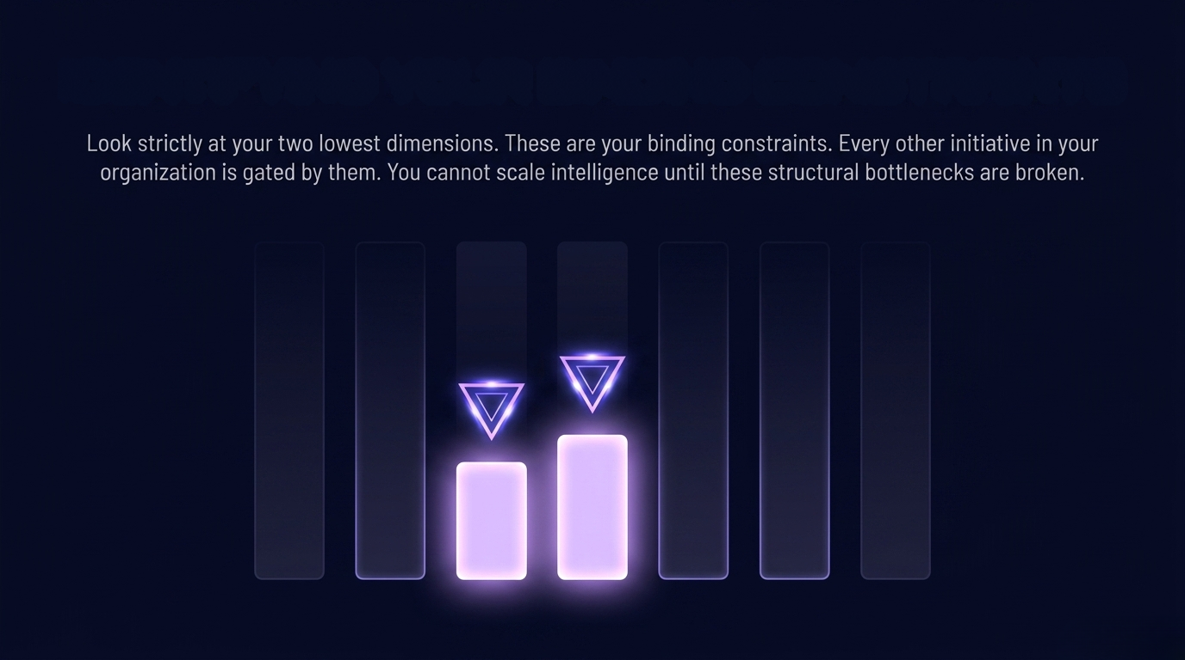
IDENTIFYING YOUR BINDING CONSTRAINTS

Slide 42
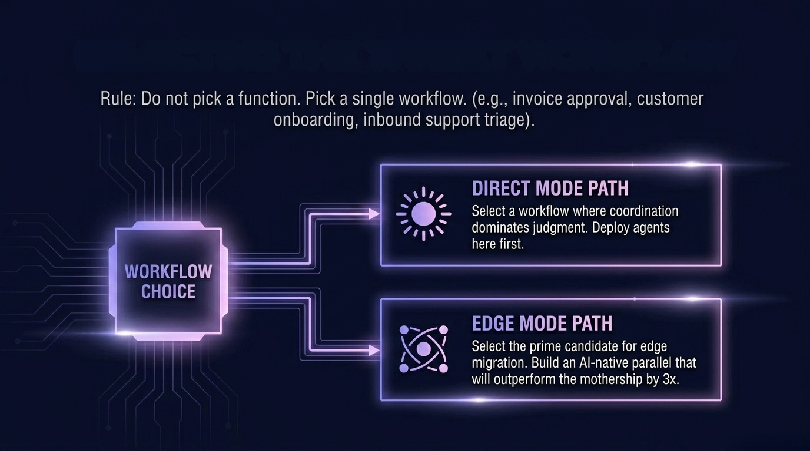
SELECTING THE TARGET WORKFLOW

Slide 43
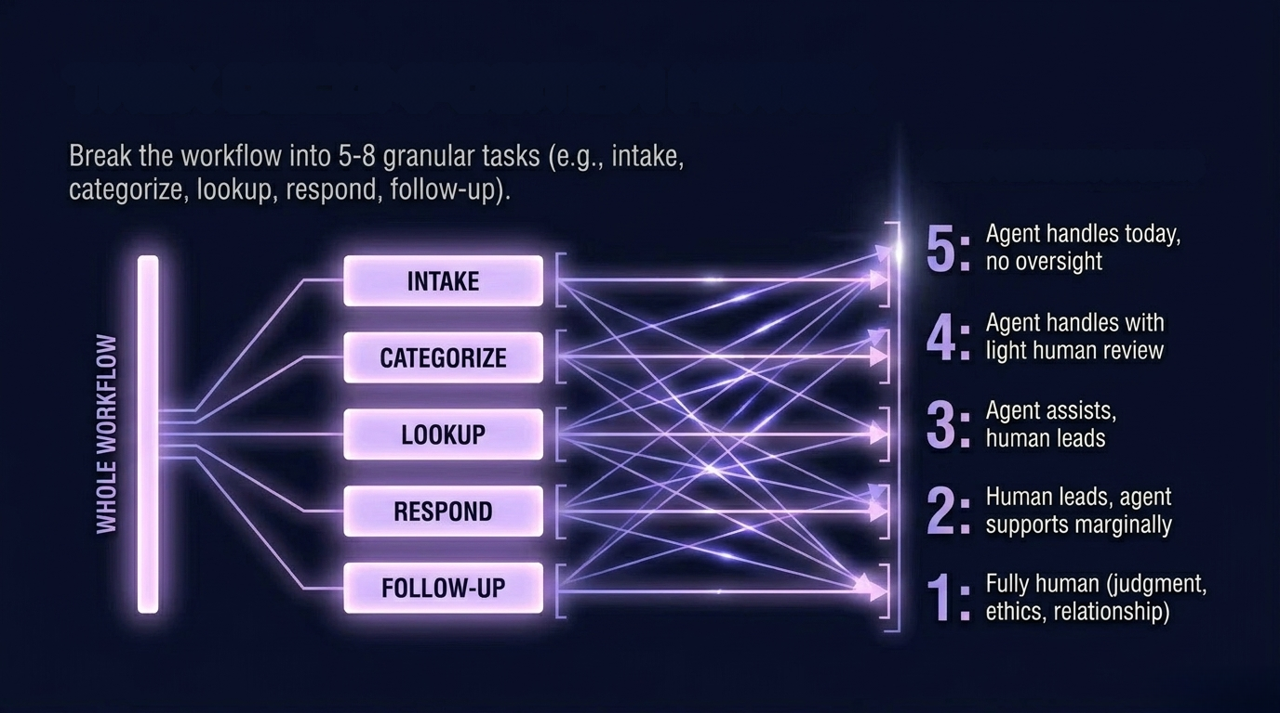
WORKFLOW TASK EXTRACTION
AGENT READINESS

Slide 44
GOVERN / ASSURE
GOVERN/ASSURE:
Monitors every layer
in real time. Logs
every decision.
Enforces guardrails.
Triggers escalations.
Owns the kill switches.

Slide 45
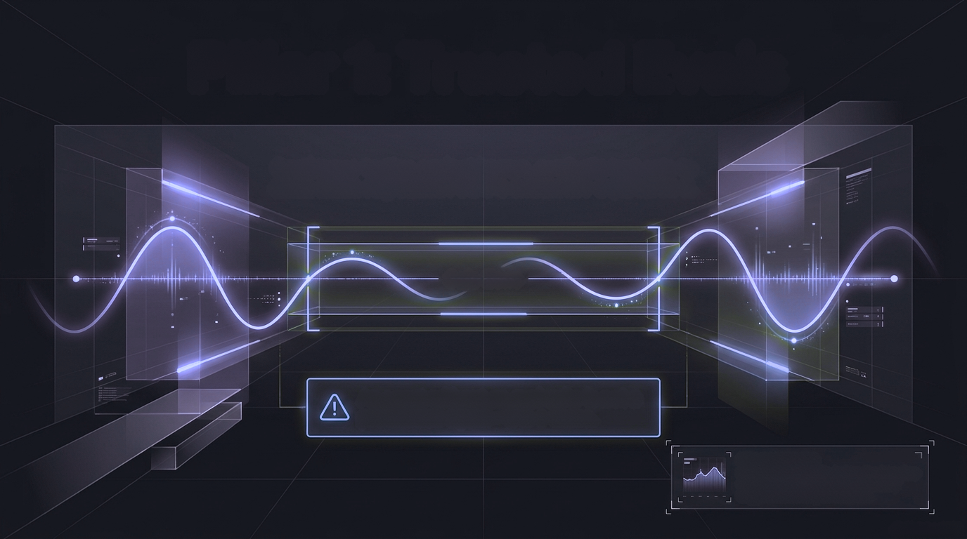
Pillar 1: Trusted Evals
Continuous testing against known, synthetic test sets to
catch silent degradation before customers experience it.
Safe Zone
An agent without an eval suite is not a
production agent, it is a demo.
KEY CAPABILITY:
If performance drifts below the baseline threshold, the system automatically triggers retraining or rollback.

Slide 46
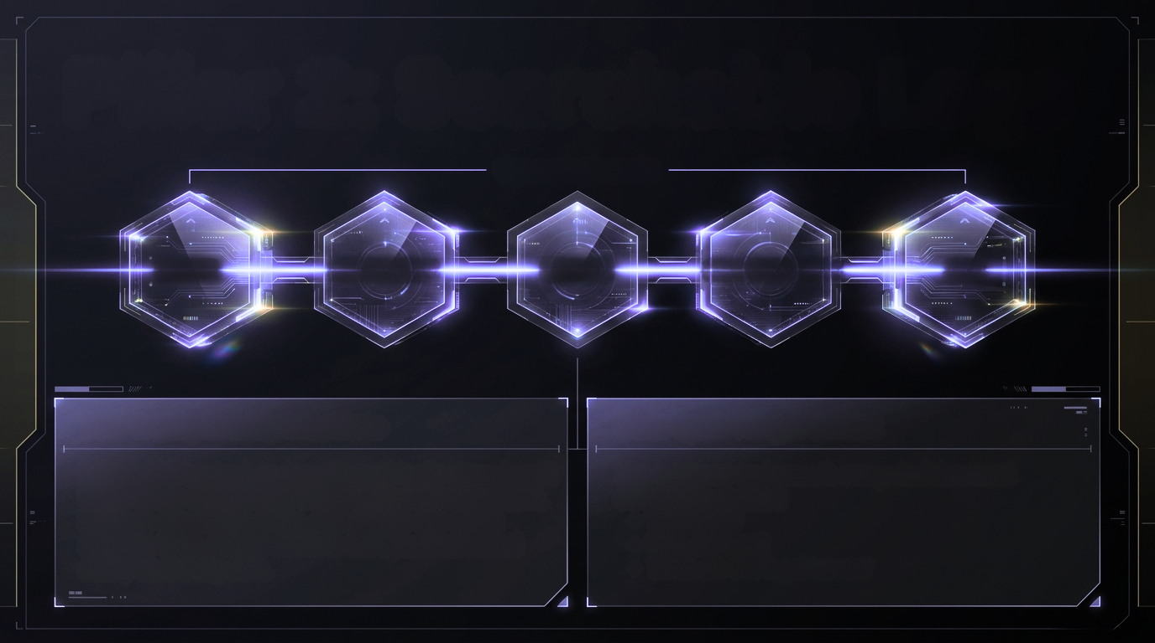
Pillar 2: Searchable Logs
Correlation ID
SENSE
INTERPRET
DECIDE
ORCHESTRATE
ACT
The Transparency Mandate
Data Spec Requirement
Immutable, hashed, and cryptographically signed audit trails. Every output must be perfectly reconstructable.
Humans can debug, trace, and explain any agent
decision to an auditor down to the byte level based
solely on the log data.
The evidence underneath every decision must
definitively answer:
• What is it?
• Who says so?
• What are the legal terms?

Slide 47
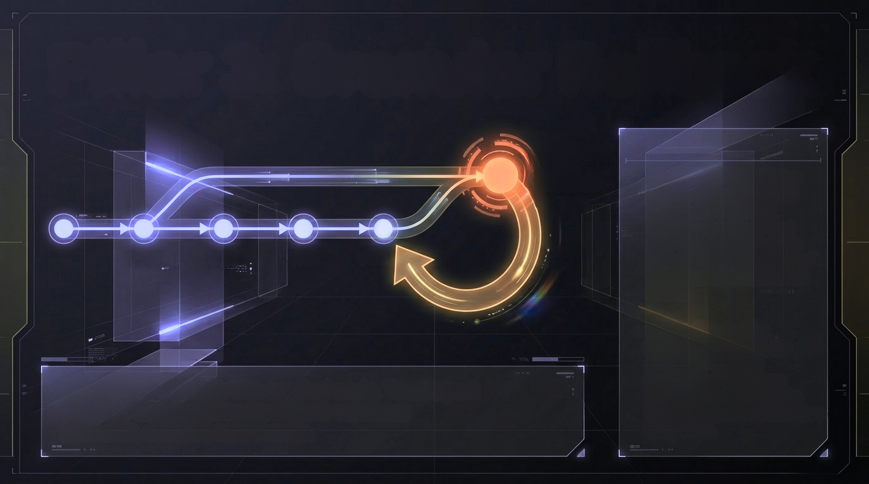
Pillar 3: Granular Rollback
Red Alert/
Policy
Violation
Operational Capability:
Revert an agent to last
week's prompt, last
month's model, or last
quarter's policy version
without taking the rest of the organizational stack offline.
v1.0
v1.1
v1.2
v1.3
Prevention Tactic:
Kill-switch thresholds
prevent 9-second
production deletions
by requiring soft-delete
windows on all destructive endpoints.
CORE MECHANISM: The surgical undo. Treat agent
versions like disciplined software versions:
traceable, diffable, recoverable.

Slide 48
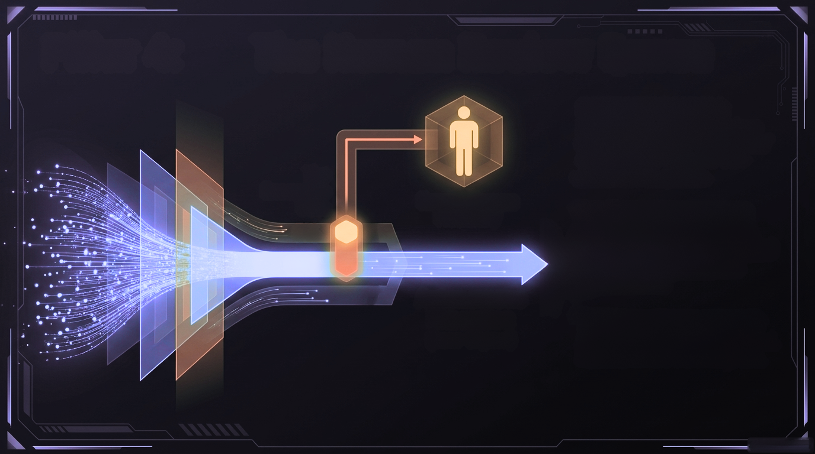
Pillar 4: The Human Review Queue
CORE MECHANISM:
High-volume, routine decisions
flow automatically. "High-Sigma"
anomalies are routed to SLA-
driven human queues.
The
Exception
Gate
Named Human
Fiduciary
THE EXCEPTION GATE:
Any decision touching money,
legal text, or customers-of-record
automatically escalates to a
named human.
5%
95%
Autonomous
Execution
(Low-Sigma)
THE NEW HUMAN ROLE:
Automation handles the expected.
Humans handle the ambiguous.

Slide 49
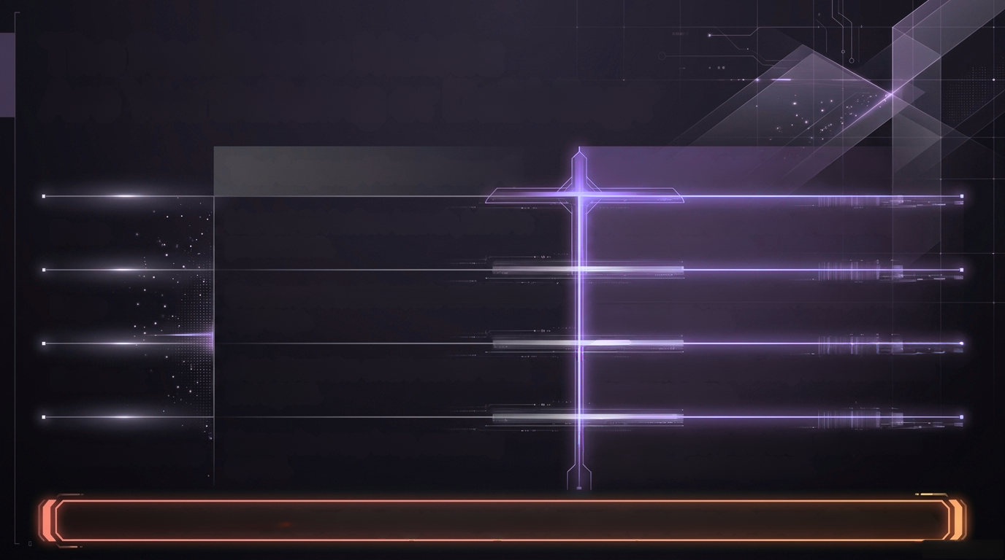
The Readiness Matrix:
Are You Building or Dabbling?
The Legacy Firm (Score 1)
The ExO 3.0 Firm (Score 5)
Evals
Manual QA before launch, blind in
production.
Continuous synthetic evaluation;
auto-halt on drift.
Logs
Scattered Slack threads and isolated
app logs.
Immutable correlation IDs spanning the entire loop.
Rollback
Shut down the entire server to fix
the agent.
Surgical prompt/policy reversion with
zero downtime.
Human Queue
Human in every loop, crushing speed.
Humans above the loop, SLA-driven
exception management.
DIAGNOSTIC MANDATE: Do not deploy a new agent class until you score a 3 across all four rows.

Slide 50
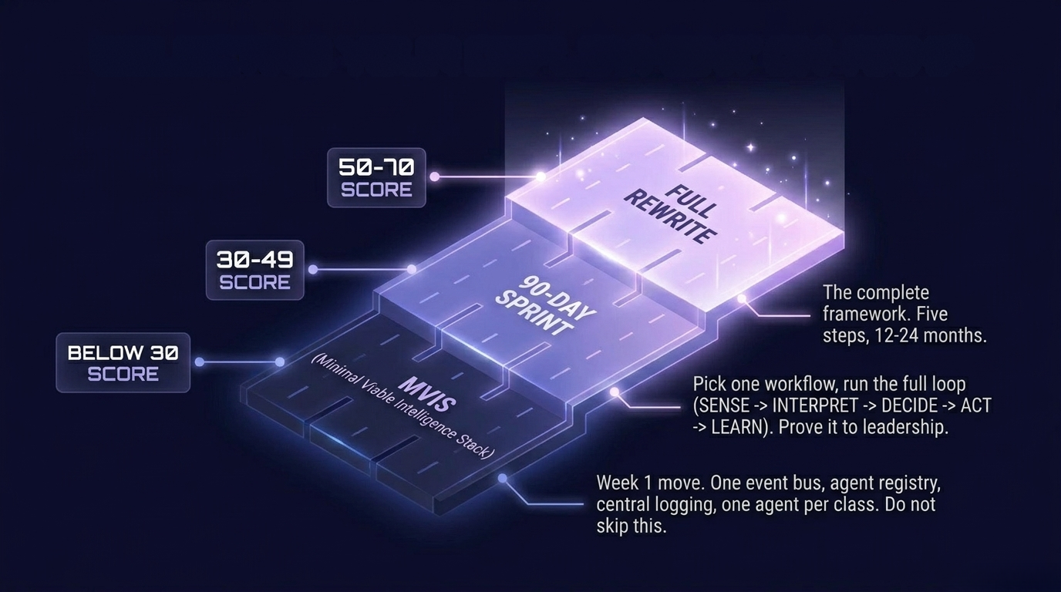
SELECTING YOUR DEPLOYMENT ON-RAMP

Slide 51
